Slide 1



BANKING MANAGEMENT SYSTEM
01

Slide 2
Created by
Software Development Capstone Project
Course Code – SE 133
Submitted to
STAR PLAYERS
Erin Jahan Eshita
0242310005341074
MD. Fardin Hasan
0242310005341393
Maliha Farzana
0242310005341062
MD. Ali Akber Rudra
Lecturer
Department of Software Engineering
Daffodil International University
02

Slide 3
Table of contents
Introduction
OBJECTIVES
METHODOLOGY
PURPOSE & SCOPE
KEY FEATURES
Other
03

Slide 4

Introduction
The Banking Management System is a software application that developed to automate and manage various banking activities, such as depositing money, withdrawing money and transferring money. The system designed to improve the performance and efficiency of banking operations, while also ensuring data security and accuracy.
04

Slide 5
objectives
A user-friendly interface that allows customers to easily navigate and perform banking operations.
Able to view and manage their transaction history.
Provide real-time access to account balances, transaction history, and other account details.
Provide notifications and alerts for important account activities, such as low balances or large transactions.
Able to customize their preferences and settings within the application.
05

Slide 6

methodology
The Bank Management System project is a software application designed to simulate basic banking operations using the C programming language. This project aims to provide a simple, user-friendly interface for bank customers to perform essential banking activities such as depositing money, withdrawing money, transferring money and viewing account details. The system is built to handle the basic needs of a customer in a bank and ensure secure and efficient management of customer data and transactions.
06

Slide 7
PURPOSE & SCOPE
The main purpose of the project is to provide a simple yet functional banking solution that allows users to manage their accounts efficiently. The scope includes: User registration and authentication. Handling deposits and withdrawals. Facilitating money transfers between accounts. Maintaining and displaying account and transaction details.
07

Slide 8
KEY FEATURES
User Registration and Logic
Deposit Money
Withdraw Money
Transfer Money
Account Details
Transaction Details
08

Slide 9
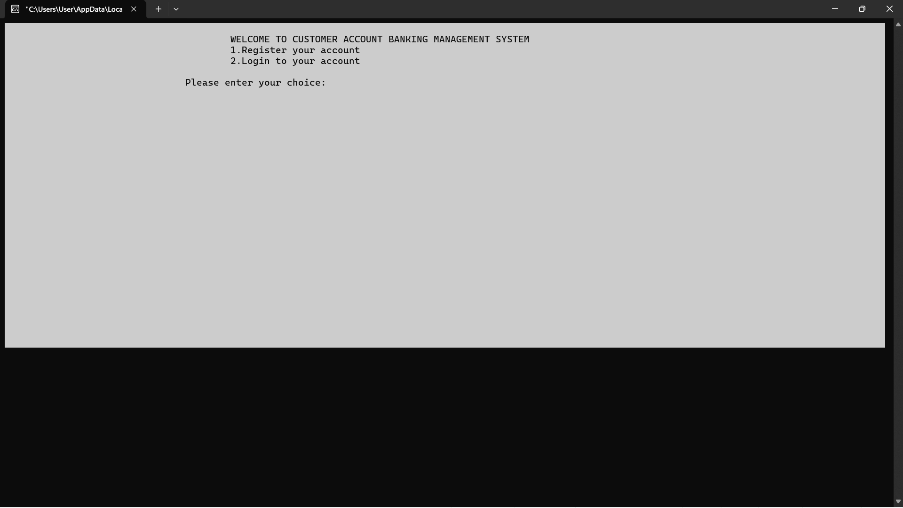
SCREENSHOT OF FEATURES (Home Page)
09

Slide 10
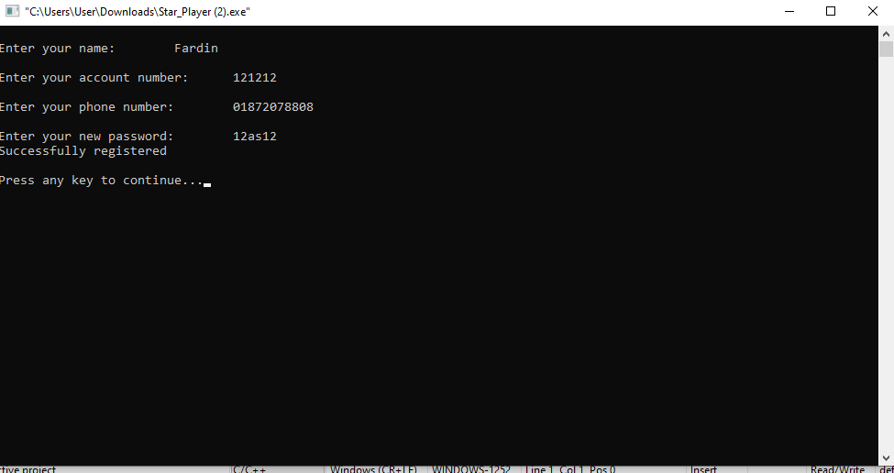
SCREENSHOT OF FEATURES (Registration)
10

Slide 11
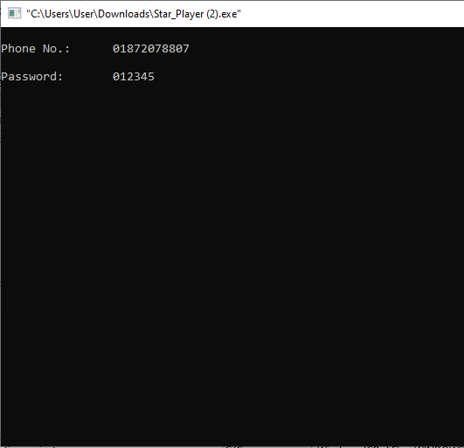
SCREENSHOT OF FEATURES
11

Slide 12
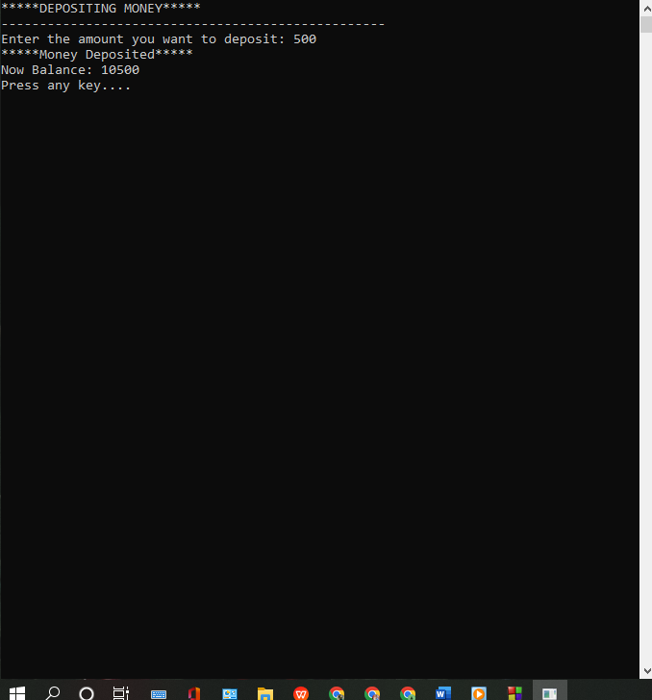
SCREENSHOT OF FEATURES (deposit money)
12

Slide 13
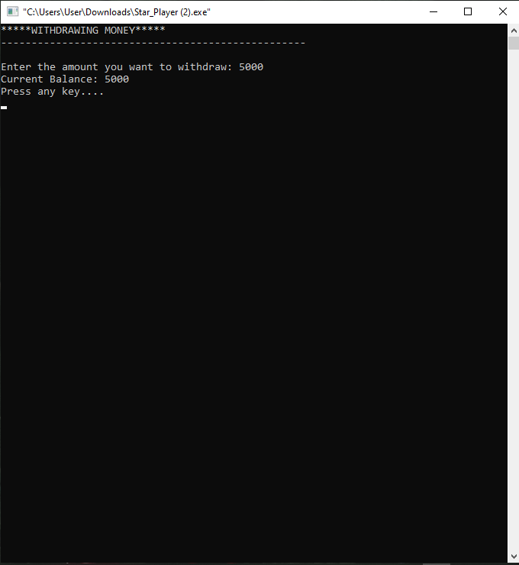
SCREENSHOT OF FEATURES (withdraw money)
13

Slide 14
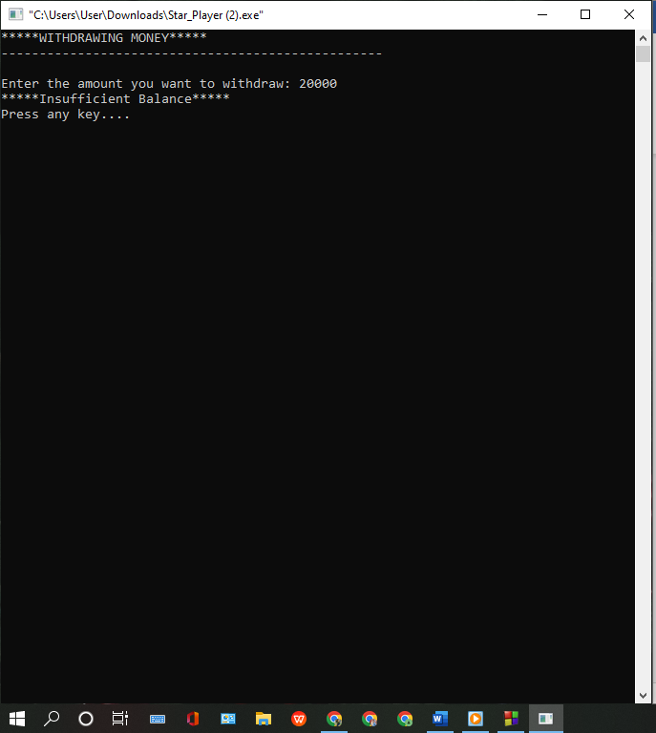
SCREENSHOT OF FEATURES
14

Slide 15
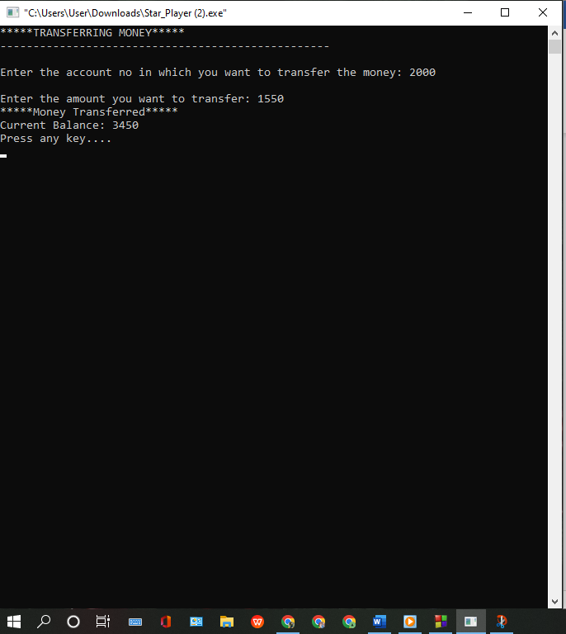
SCREENSHOT OF FEATURES (transfer money)
15

Slide 16
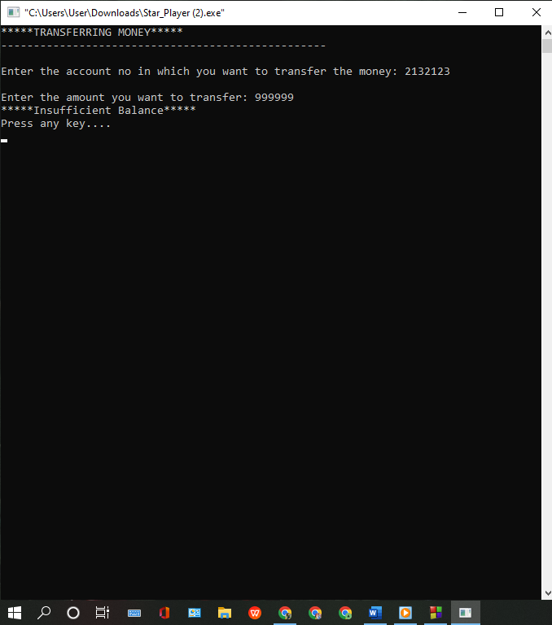
SCREENSHOT OF FEATURES
16

Slide 17
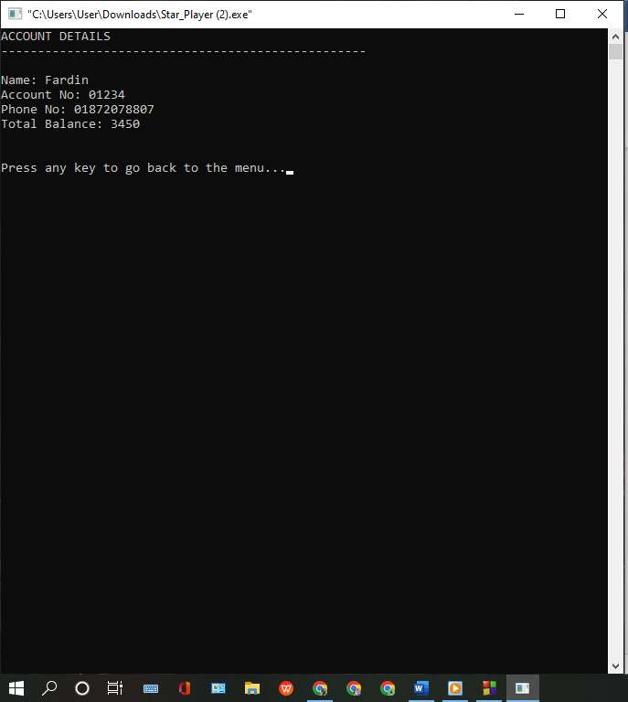
SCREENSHOT OF FEATURES (account details)
17

Slide 18
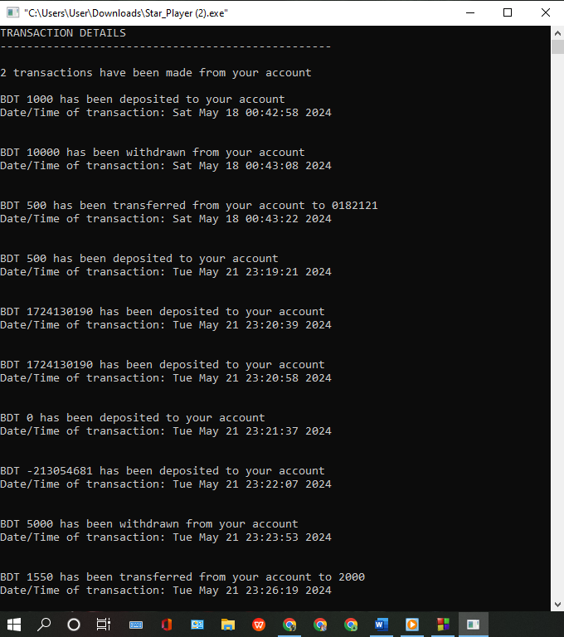
SCREENSHOT OF FEATURES (transaction details)
18

Slide 19

SCREENSHOT OF FEATURES
19

Slide 20
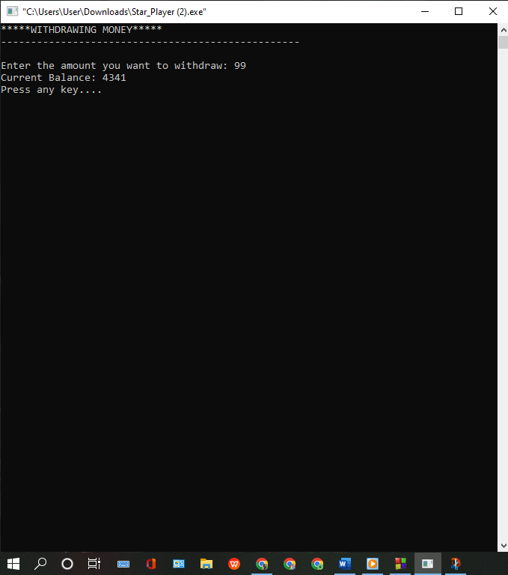
SCREENSHOT OF FEATURES
20

Slide 21
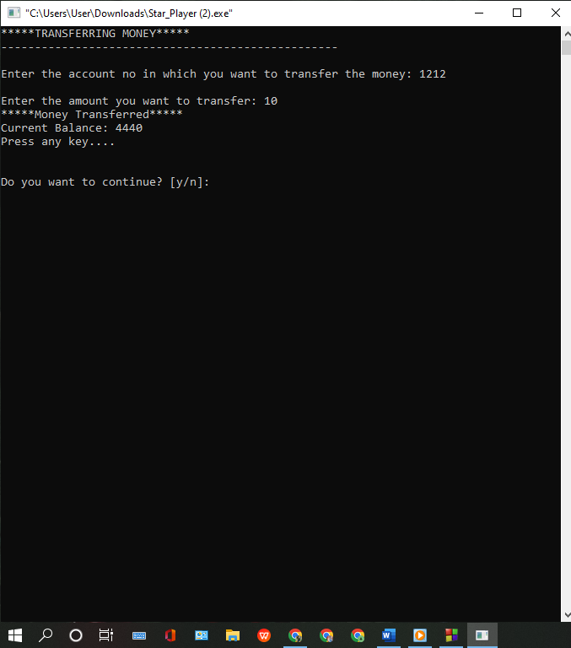
SCREENSHOT OF FEATURES
21

Slide 22
limitations
1. After completing the registration process, the screen turns off.
2. Once exited from the output, the amount remains static, indicating missing file handling.
3. Money transfers to other accounts do not work properly.
4. Error handling limitations: The system accept any phone number.
22

Slide 23
CONCLUSION
This project is developed to nurture the needs of a user in a banking sector by embedding all the tasks and transactions taking place in a bank.
23

Slide 24
references
Textbooks and Books
- Kernighan, B. W., & Ritchie, D. M. (1988). *The C Programming Language* (2nd ed.). Prentice Hall.
Online Tutorials and Articles
- "Learn C Programming" (2023). *TutorialsPoint*. Retrieved from https://www.tutorialspoint.com/cprogramming/index.htm
Official Documentation
- Microsoft Documentation. (2023). *<windows.h> header*. Retrieved from https://docs.microsoft.com/en-us/windows/win32/api/
Development Tools and Libraries
- GCC (GNU Compiler Collection). Retrieved from https://gcc.gnu.org/
Other Resources
- "Introduction to Pointers in C" (2023). *YouTube Video*. Retrieved from
https://youtu.be/f2i0CnUOniA?si=t2tVULEgXzleQapX
24

Slide 25
Thank YOU!

